Slide 1
Bibliometrics & Citation Analysis of Pakistani Researchers in the Field of Computer Science
ALI KHALID MSDS21001 MUHAMMAD AHMAD MSDS21021
MUHAMMAD TAYYAB MSDS21032 HAIDER ALI ADEEL MSDS21044

Slide 2
OVERVIEW
DATA COLLECTION
DATA PREPROCESSING
DATA ANALYSIS

Slide 3
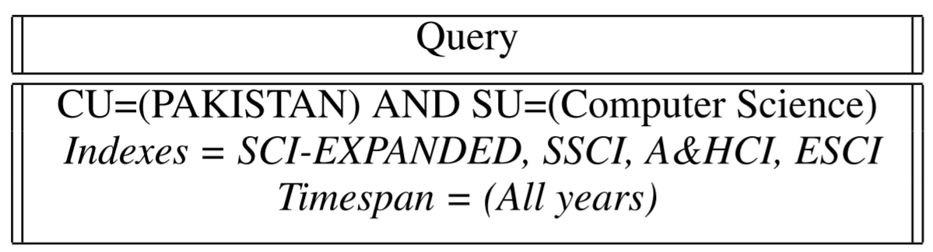
DATA COLLECTION
Advance Search, Web of Knowledge of Clarivate Analytics
Returns data as text files.

Slide 4
DATA PREPROCESSING
Text Files
CSV
Text Files
CSV
CSV
Text Files
CSV
Text Files
CSV Files

Slide 5
DATA PREPROCESSING
The data-set contains
8843 rows
60 Columns
Abbreviated names of columns
Scrap column mapping from sciencescape
Feature Selection
22 out of 60

Slide 6
DATA PREPROCESSING
AU (Authors)
AF (Author Full Name)
TI (Document Title)
SO (Publication Name)
DT (Document Type)
DE (Author Keywords)
AB (Abstract)
C1 (Author Address)
EM (E-mail Address)
NR (Cited Reference Count)
TC (Times Cited) Z9
(Total Times Cited Count)
PU (Publisher)
PD (Publication Date)
PY (Year Published)
PG (Page Count)
WC (Web of Science Categories)
SC (Subject Category)
FU (Funding Agency and Grant Number)

Slide 7
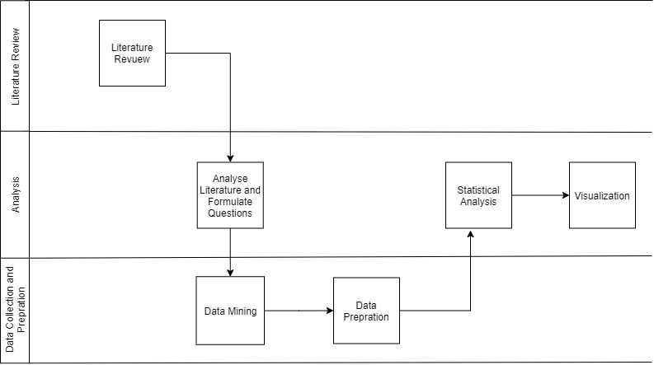
Bibliometrics & Citation Analysis

Slide 8
Citation Analysis
Citation analysis is the process of evaluating and interpreting the citations that articles, scientists, universities, and countries receive to determine their scientific influence and productivity

Slide 9
Lotka’s law
Discrete probability distribution function that tells the author productivity within that domain
"the number (of authors) making n contributions is about 1/n² of those making one; and the proportion of all contributors, that make a single contribution, is about 60 percent”

Slide 10
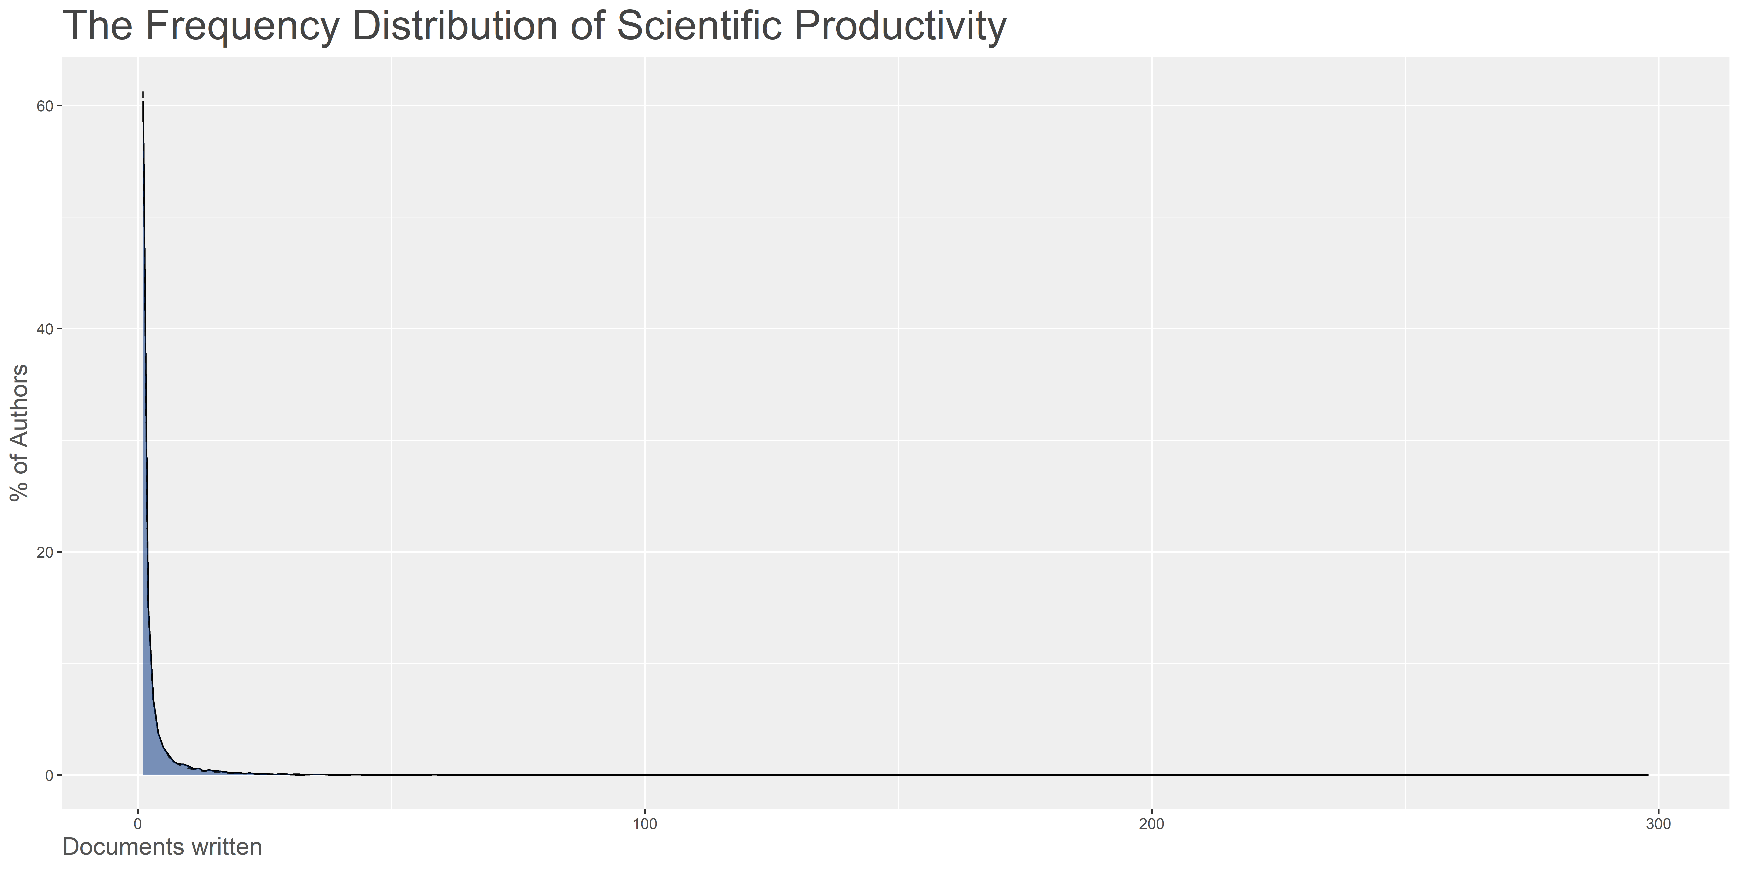
Lotka’s law

Slide 11
Bradford’s Law
A core of journals on the subject, relatively a few, that produces approximately one-third of all the articles.
A second zone, containing the same number of articles as the first, but a greater number of journals.
A third zone, containing the same number of articles as the second, but a still greater number of journals
Bradford expressed the relationship between 3 zone as 1:n: n²

Slide 12
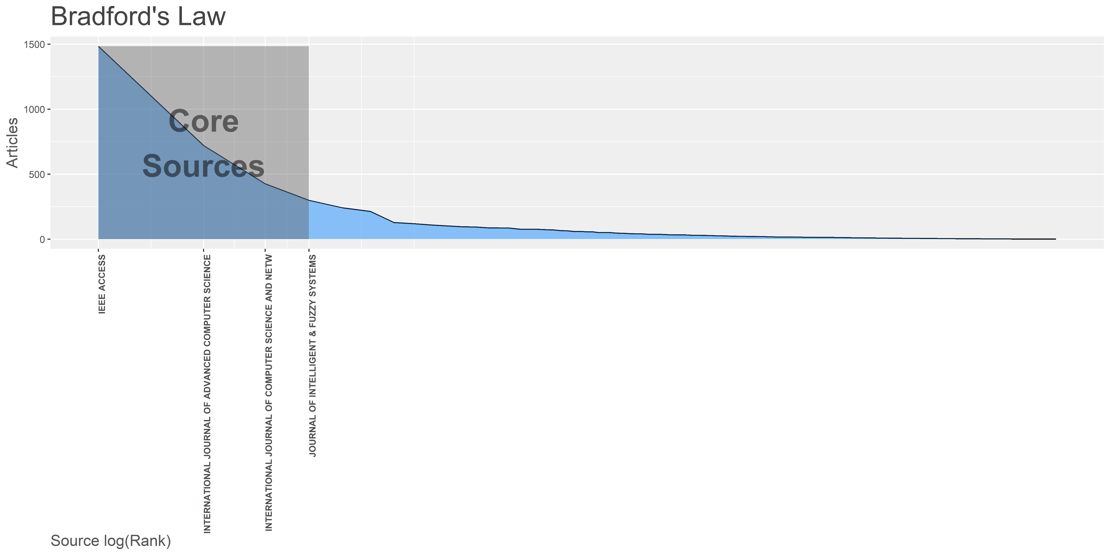
Bradford’s Law

Slide 13
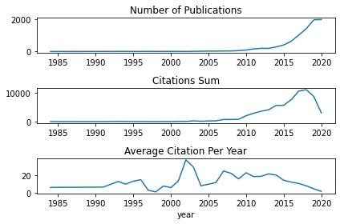
Average Citation per Year

Slide 14
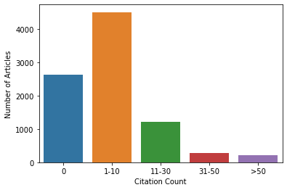
Citation Distribution

Slide 15
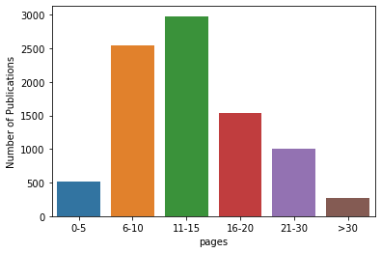
Page Count Distribution

Slide 16
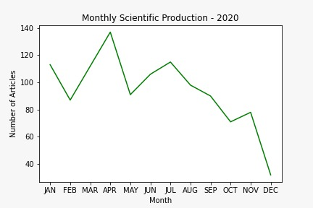
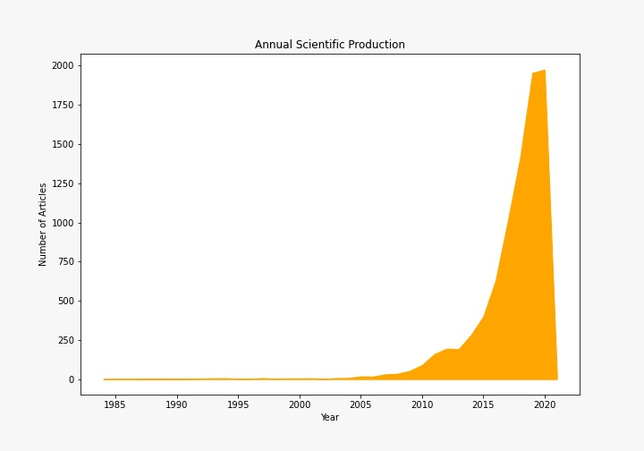
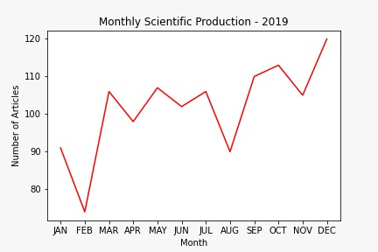
Annual Scientific Production

Slide 17
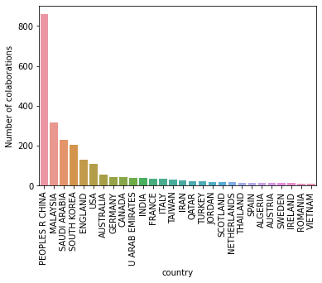
Collaborations

Slide 18
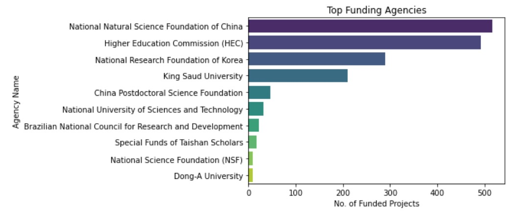
Top Funding Agencies

Slide 19
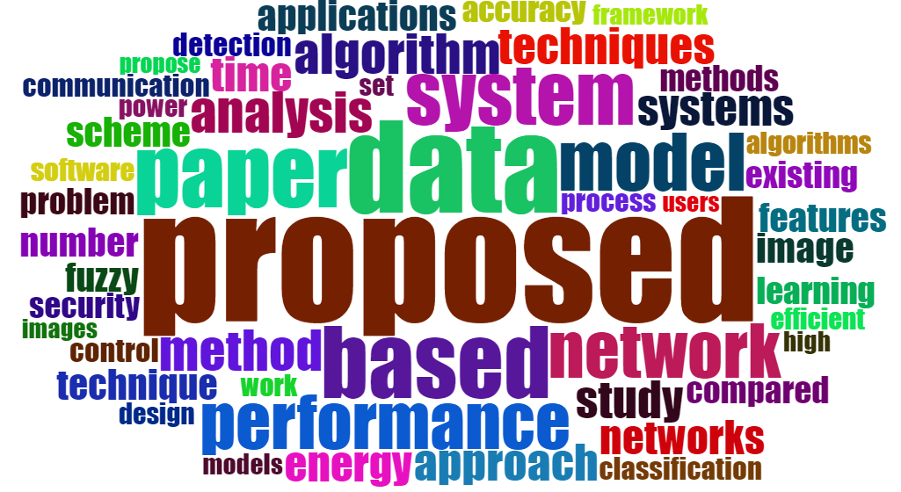
Abstract Word Cloud

Slide 20
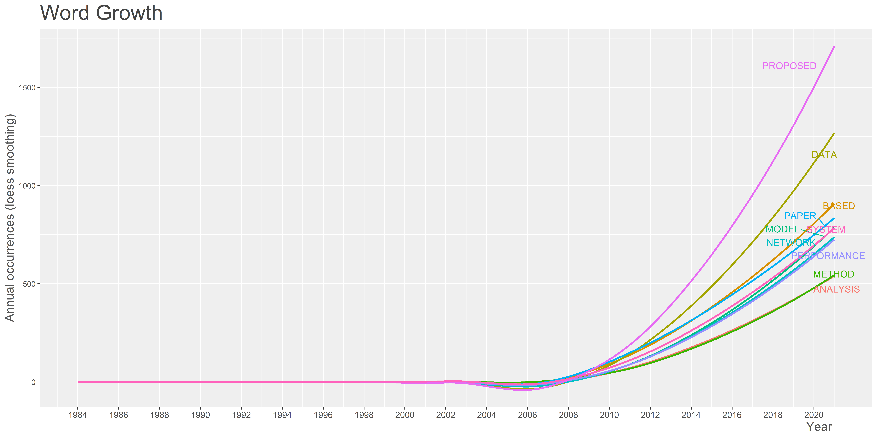
Abstract Word Growth

Slide 21
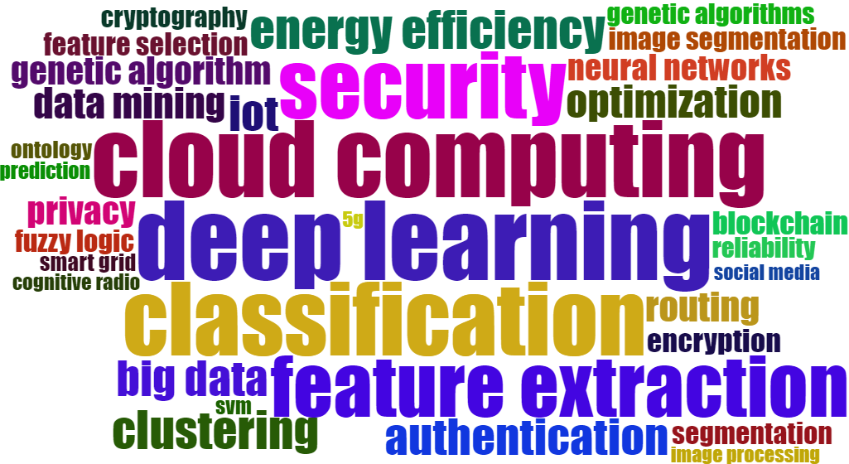
Keywords Word Cloud

Slide 22
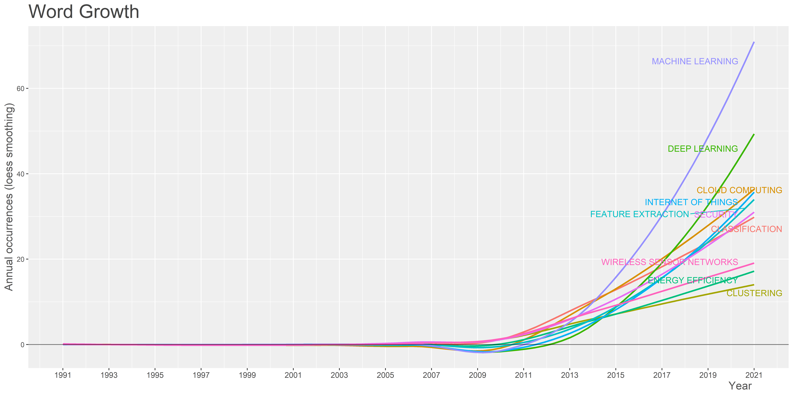
Keywords Word Growth

Slide 23
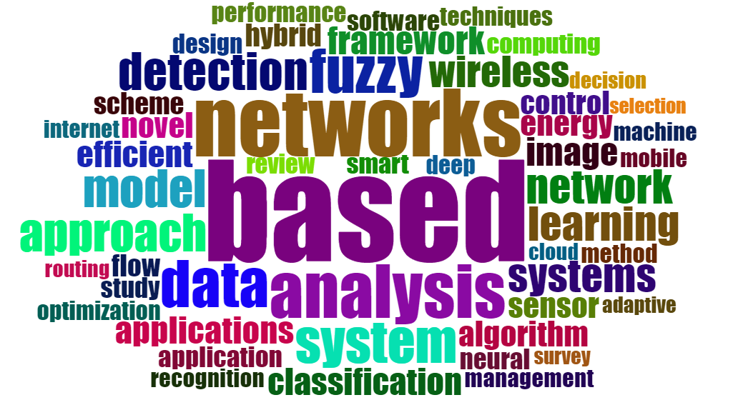
Title Word Cloud

Slide 24
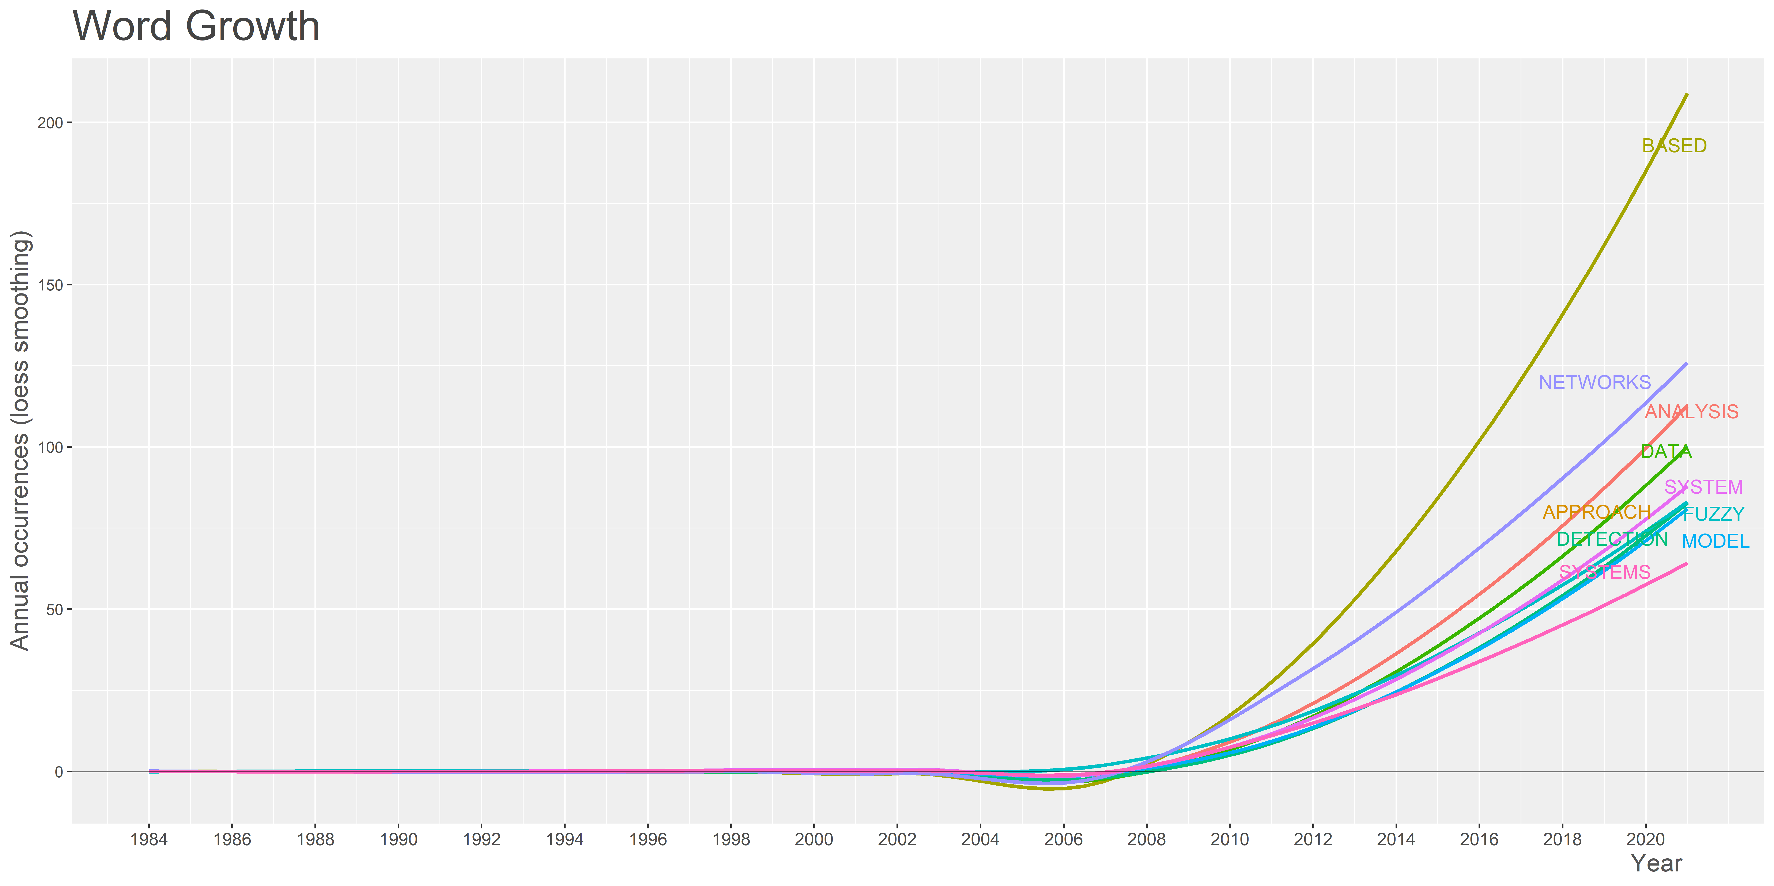
Title Words Growth

Slide 25
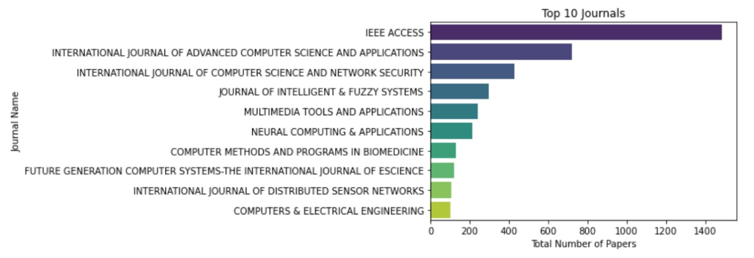
Top 10 Journals

Slide 26
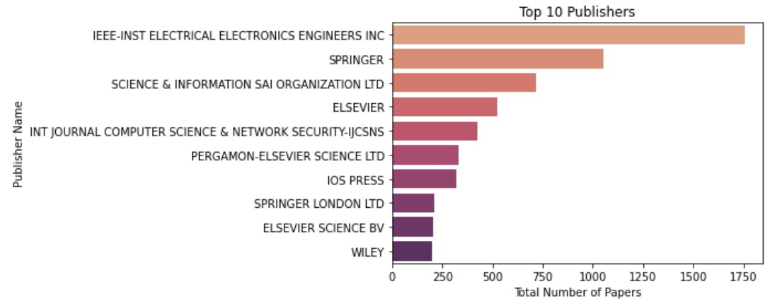
Top 10 Publishers

Slide 27
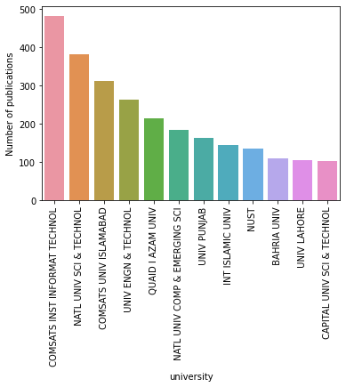
Top Universities

Slide 28
Conclusion
Data Science (Machine Learning, Feature extraction etc.) is the hot topic in the domain of computer science followed by cyber security.
Foreign collaborations mostly depends on the funding.
COMSAT is the leading university, considering publications in which Pakistani author is the first author.
IEEE Access is the favorite venue of publication of Pakistani researchers.

Slide 29

Question?

